Slide 1
Music Teleportation
Alex Thomas
Joaquin Quintana
Timur Boskailo
Samuel Steingard

Slide 2
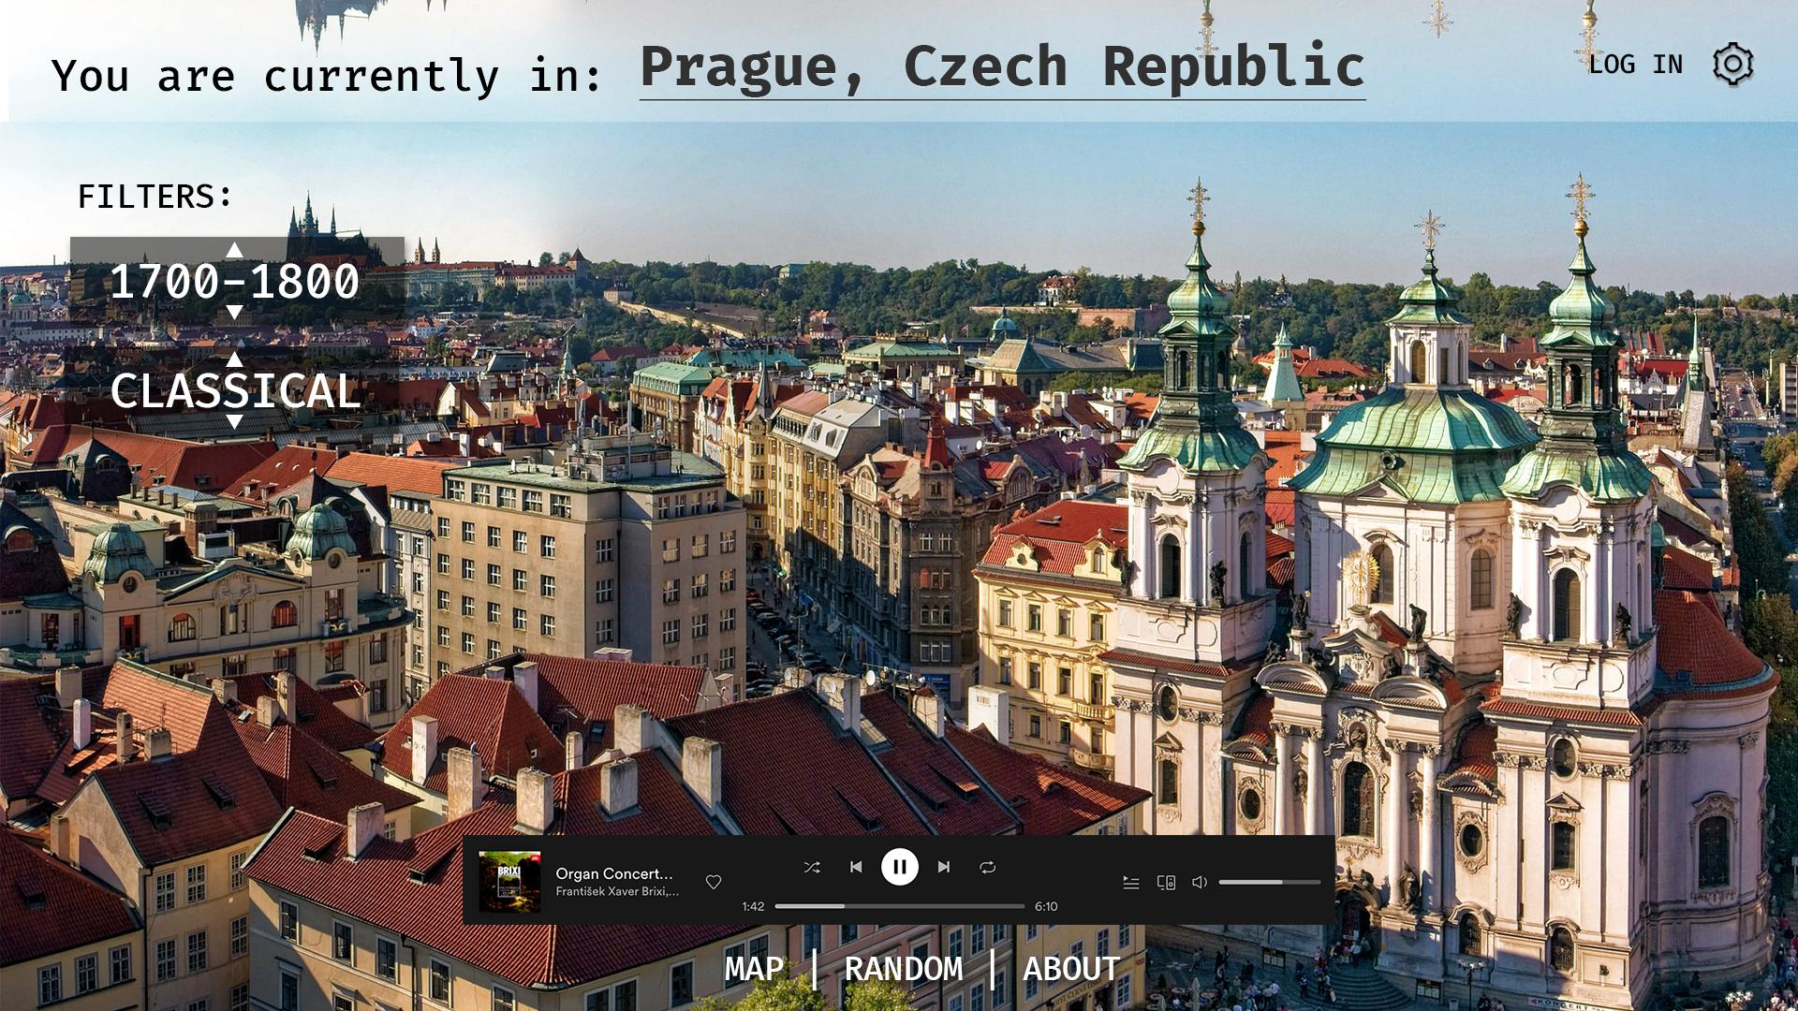
Concept

Slide 3
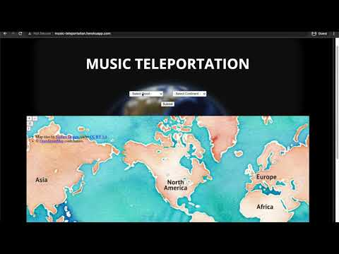
Demo
Notes:
Sam
So here is a short demonstration of the music teleportation app that we developed over the semester. On initial page load the user is met with the following page that houses the main controls of our Music Teleporter. We have our menu up top to describe the different pages or actions that can be viewed by the user.
Next we have the app title at the top of the music teleportation form. The user is given two lists of options to choose from when teleporting, one for the mood and one for the continent. And when they have made their final selection they can click the submit button to refresh the page with the newly updated map and playlist.
Below we can see the map that Joaquin talked about earlier, which is displayed and updated using the OpenStreetMap API. We chose to go with a different theme on this map to try and better fit the theme of the teleportation device.
Below that we can see the generated spotify playlist view that contains the results of our users “teleportation” query. These playlists were curated by Timur and are specific to the selected mood and region for each possible user input. As mentioned before, to generate the view we used the spotify “embed playlist” functionality along with some python scripting to make it flow.
So lets try it out real quick, pretend that were a user looking to teleport to south america and we’re looking for an energetic vibe. We enter those options and we can click submit to refresh the page… Scroll down past our view of the continent we have teleported to and then see the generated playlist associated with that mood and location.
I’m gonna run another demo to just highlight the versatility of our application, this time we can try the same thing on mobile. So lets say again I’m loading the page initially, and I want to teleport to Australia with a Happy vibe. I can click on those options, click submit and as you can see the page works perfectly on mobile. Overall, Heroku proved to be a valuable asset as we moved forward with our project and really let us share our work with our friends and family!
______________________________________
Because we wanted to use this page in our personal portfolios we decided a contact page would be a useful feature for anyone visiting that tries to get in touch with us. Alex worked hard on the SQL backend to make the contact form work flawlessly and even developed a database admin panel to let us easily check on what messages that have been sent into the database.
I’ll run a quick demo on this functionality to show everyone what a potential contact event would look like. So let’s say we are an investor interested in the application and want to get in touch with the creators! To do this from the home page we would simply need to use the navigation bar, click on the text labeled “Contact” and we’re taken to the contact form. We can enter our name, email and message and when we click submit, our message is sent to the database for the page admin to view!
After this message is sent we have the ability to view it in the admin panel, all we have to do is click on the navigation text labeled “DB Admin” and we are shown a password entry dialog where we have to enter our very secure password which is “mypassword”. After entry we are granted access to the DB admin panel that displays all of our previously entered messages!
We were all excited to see this page work in the final project because it was a great application of the SQL knowledge we got from Lab 7 and it is also something very functional that any of us could transfer to our personal sites!
And with that the demo portion of our presentation is wrapped up, I hope everyone enjoyed seeing what we worked on this semester!

Slide 4
Flask Infrastructure
Flask - flask is a web development software which is integrated with Python, Jinja and Werkzeug.
Jinja - is a templating engine which has been developed to have a similar syntax to python
Werkzeug - is web server gateway interface (WSGI)
Using the Flask framework we were able to use python and a set of modules which made working with the backend and frontend a little cleaner.
Notes:
Joaquin
Web server gateway interface is a simple calling convention for web servers to forward requests to web applications or frameworks written in the Python programming language.

Slide 5
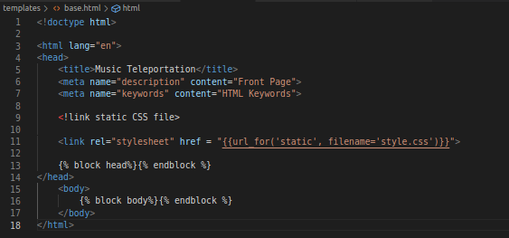
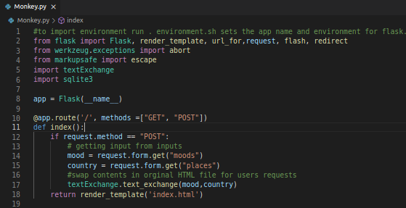
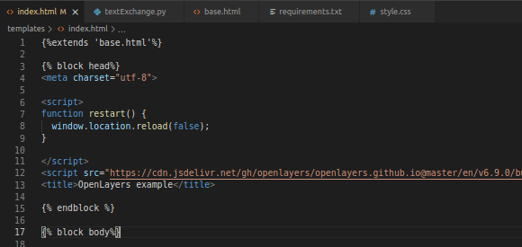
Templates
Python file using the Flask infrastructure
Static HTML is exchanged upon request using Pandas and Regex.
Challenge which I will talk about later

Slide 6
Web Applications
OpenLayers - is an open source library primarily written in Javascript. The API provides an extensive environment for exploring dynamic maps.
Spotify - We created a set of playlist which could then be stored as an iframe and exchanged dynamically upon users request.
Notes:
Joaquin

Slide 7
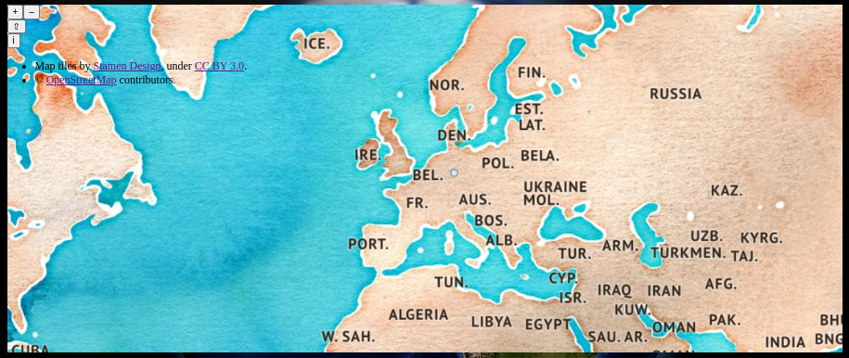
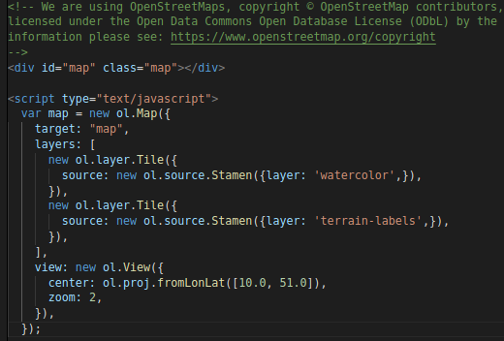
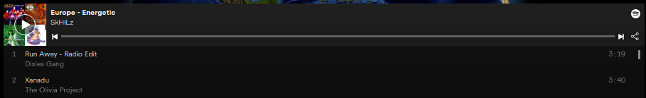
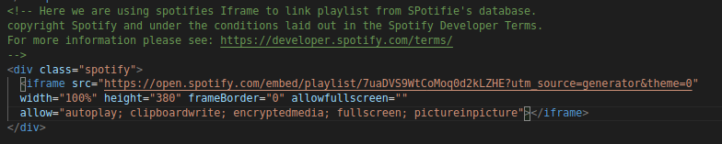
Web map and Spotify Iframes

Slide 8
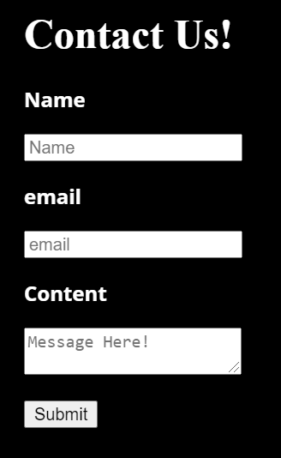
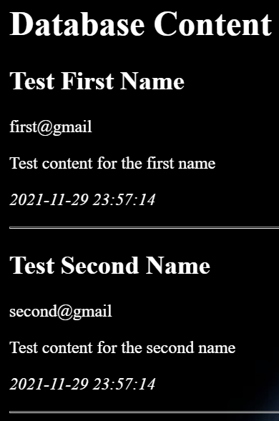
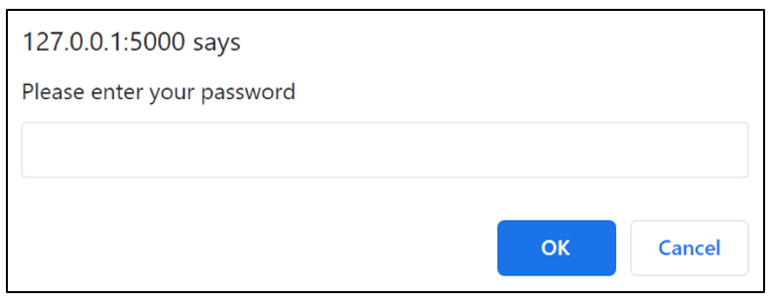
Tool 2 - SQL/database
method = post
INSERT INTO contacts
database.db
schema.sql → init_db.py
javascript prompt
OK (T) → DB Admin
OK (F) → loop
Cancel → Home
SELECT * FROM contacts

Slide 9
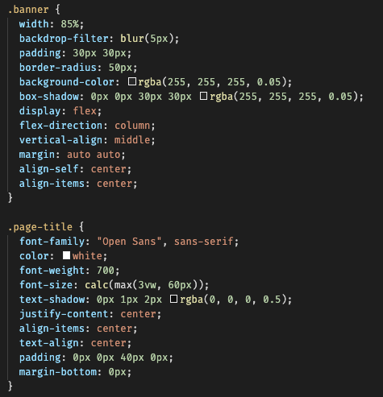
Tool 3 - CSS
CSS is a styling language that pairs with HTML
Natively understood by the browser - all webpages use CSS
Sometimes hard to use
Overall very useful and versatile
Notes:
Sam

Slide 10

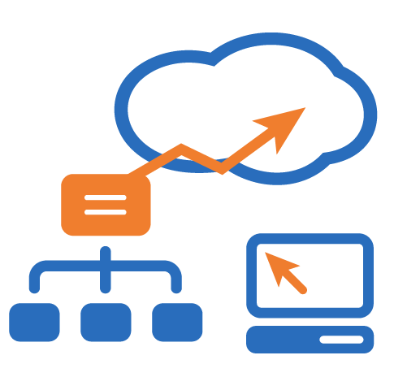
Tool 4 - Heroku
Heroku is a PaaS (Platform as a Service)
All wanted our app to be “live”
Used in lab so implementation was easy
Maintains version control for all users
Very Useful!
Notes:
Sam

Slide 11
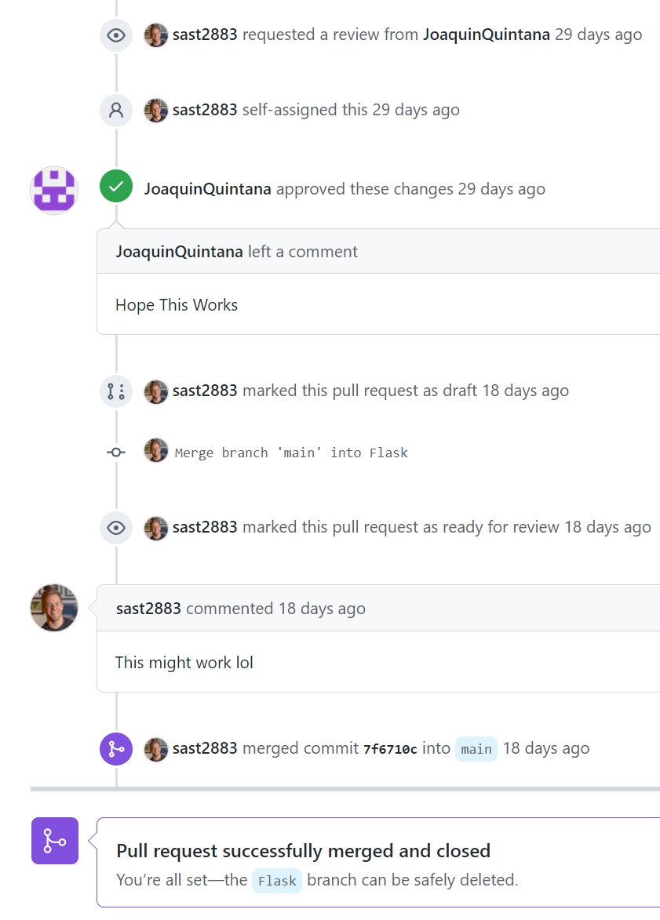
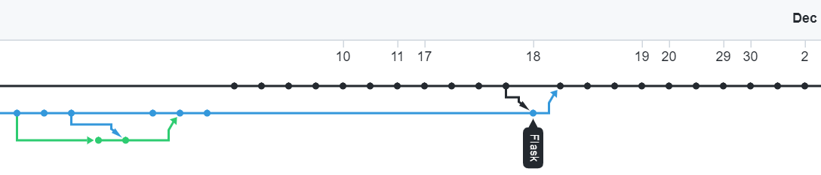
Challenge 1 - Git(Hub)
Git = excellent version control, surprisingly nuanced
Learning curve for the process:
Fetch → Pull
Add → Commit → Push
Many merge attempts from “Flask” branch into main
Notes:
Merge was successful after manually fixing commit conflicts one-by-one

Slide 12
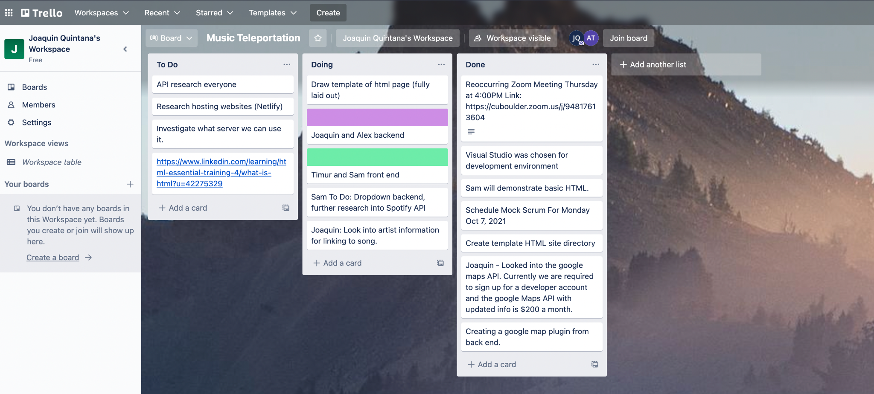
Challenge 2 - Project Tracking (Trello)

Slide 13
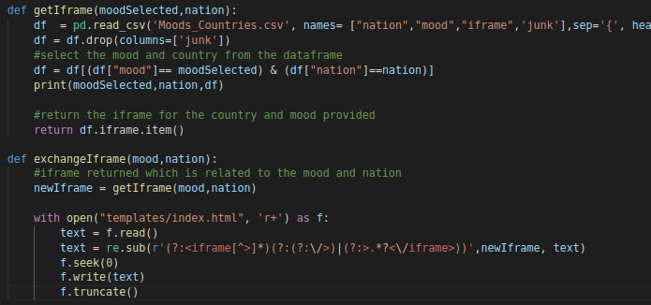
Challenge 3 - Regex or Javascript
Notes:
Manipulating static HTML dynamically prior to learning javascript.
In lieu of Javascript we used python and regex to perform pattern matches and dynamically update the HTML document.
In sight of learning Javascript it would have been a better choice to use it instead of regex to update the HTML files dynamically. It is standard practice and more efficient than performing the pattern matching.

Slide 14
Questions

